Slide 1

Big Mountain Resorts
Montana

Slide 2
The problem
How could Big Mountain ski resort in Montana make up for the new incurred expense in installing and operating the new lift?
Stakeholders:
Jimmy Blackburn : Director of Operations
Alesha Eisen : Database Manager

Slide 3

Criteria of success
an increase in income or decrease of operation costs of at least $1,540,000

Slide 4
Scope of Solution Space
cutting cost without undermining the support for ticket price / increase the ticket price

Slide 5

Constraints within solution space
Data shortage: -Operational cost -Facilities data -Employment data -Occupancy and visitor data

Slide 6

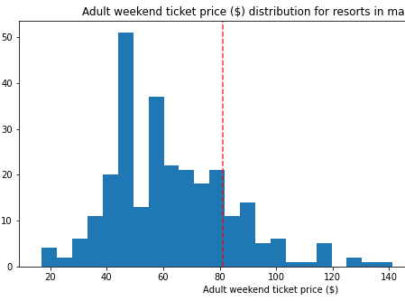
Recommendations
1- Big Mountain Resort modelled price is $95.88, actual price is $81.00. Even with the expected mean absolute error of $10.36, this suggests there is room for an increase.

Slide 7
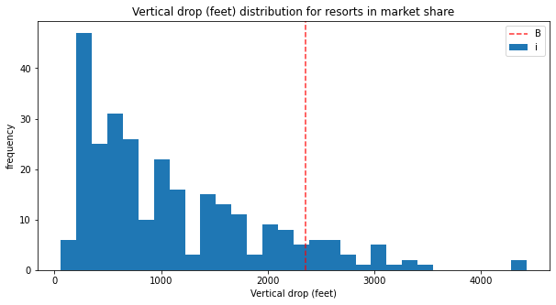
Recommendations
2- Big mountain can add a run and increase it’s vertical drop by $1.61 per ticket and would generate $2,815,217 through the season.

Slide 8
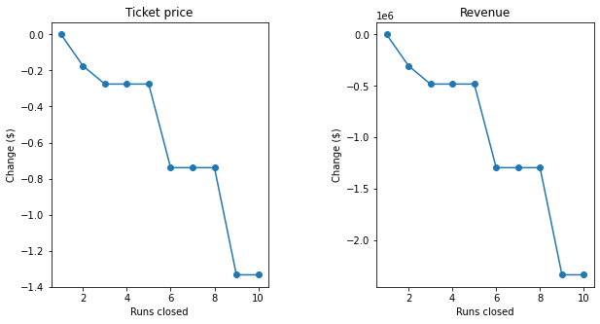
Recommendations
3- Big mountain could close one run without affecting the ticket price.

Slide 9
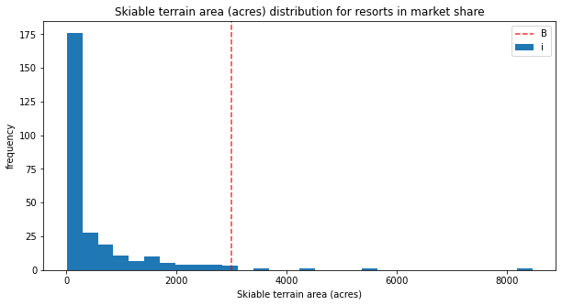
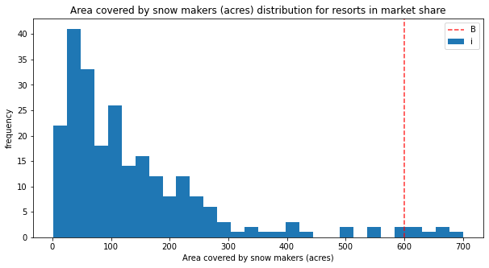
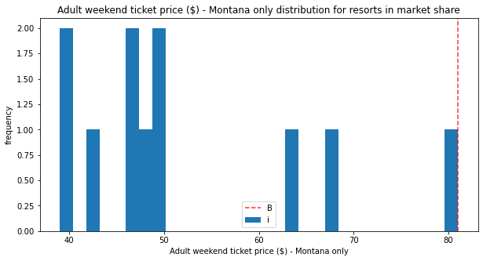
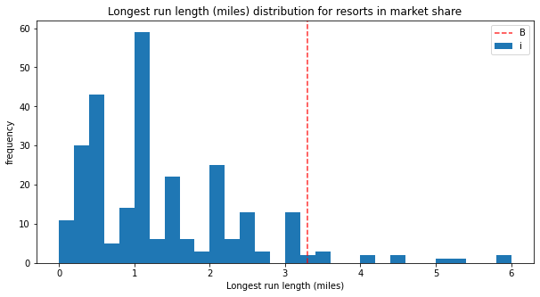

Slide 10
Modeling and Key Findings
The resort scores at the higher end of pricing
The resort is :
On the Higher end than average chair numbers
On the Higher end than average total number of runs
Higher than average length of runs
On the higher end of skiable terrain

Slide 11
Scenarios:

Slide 12
Scenario 1
The Model predicted no increase in ticket price if The longest run was increased by 0.2 miles

Slide 13
Scenario 2
The model says closing one run makes no difference. Closing 2 and 3 successively reduces support for ticket price and so revenue. If Big Mountain closes 3 runs, it seems they may as well close 4 or 5 as there's no further loss in ticket price. Increasing the closures down to 6 or more leads to a large drop.

Slide 14
Scenario 3
adding a run, increasing the vertical drop by 150 feet, and installing an additional chair lift will increase support for ticket price $1.61 . Total over the season Over the season $2,815,217

Slide 15
Scenario 4
Removing a run will not affect the support for ticket price .
Removing 2 or five runs will decrease the ticket price at the same rate

Slide 16

Summary
Ticket price should be increased to $85
For further cost reduction and operations cost management , further studies should be conducted with adequate data .

